Slide 1

SFML w/ CLion on Windows
FGCU Software Engineering

Slide 2
CLion IDE
The following tutorial will assist you with installing and setting up CLion on Windows
Tutorial: Configure CLion on Windows
You will need to register with JetBrains.com using your Eagle email address. You will be sent a license typically within 24 hours, but may use the product in trial mode until then.

Slide 3
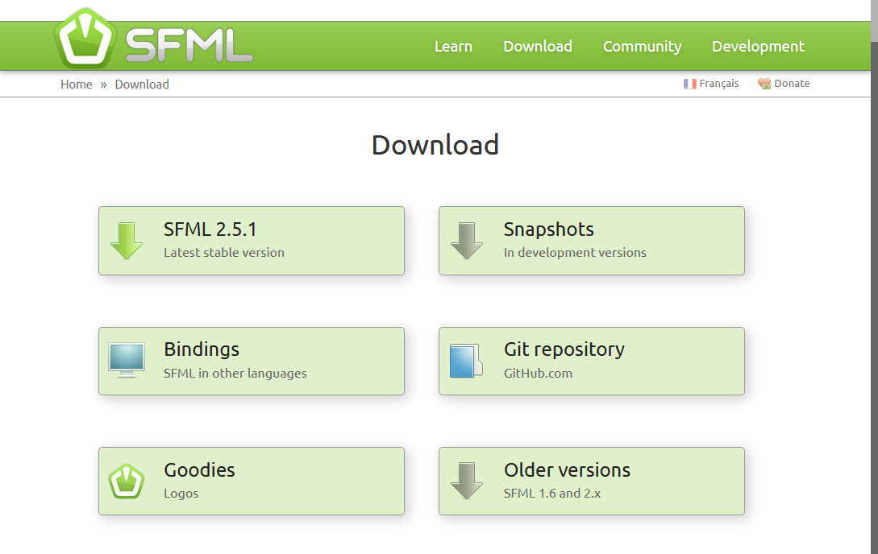
SFML Download
Open an Internet browser and go to URL:
sfml-dev.org/download.php
Click SFML 2.5.1

Slide 4
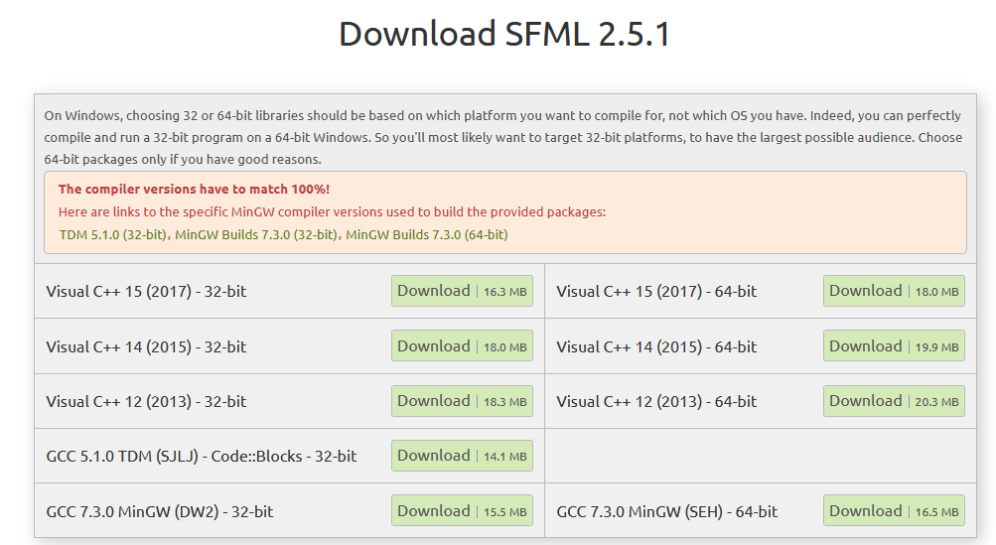
Requirements
Must match the MinGW Build with the SFML binaries (pre-compiled libraries)
Download the MinGW Builds 7.3.0 for 64-bit
Download the SFML libraries built with GCC 7.3.0 MinGW (SHE) – 64-bit
Alternatively, choose the MinGW Builds 7.3.0 (32-bit) and the SFML libraries GCC 7.3.0 MinGW (DW2) – 32-bit (if you have a 32-bit only system, which is unlikely)

Slide 5
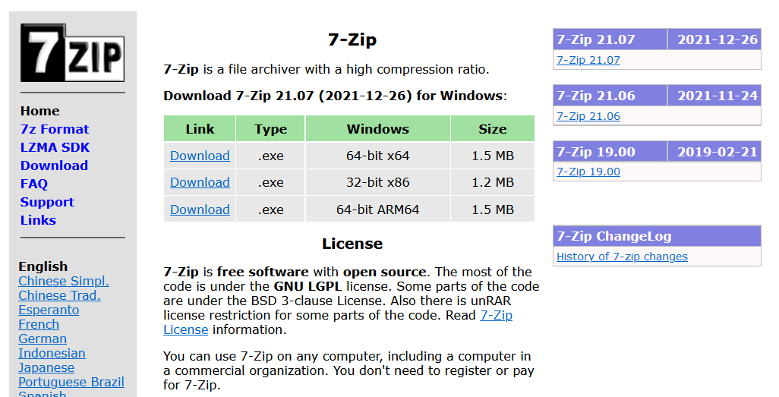
Download 7zip
7zip is a tool for compressing and uncompressing archives in the 7z, zip, jar, rar, and other archive formats.
Visit: https://www.7-zip.org/
Download the Windows 64-bit x64 .exe
Save the executable to your Downloads folder
Go to your executable folder and run the install (e.g. 7z2107-x64.exe)
Choose default options during install

Slide 6
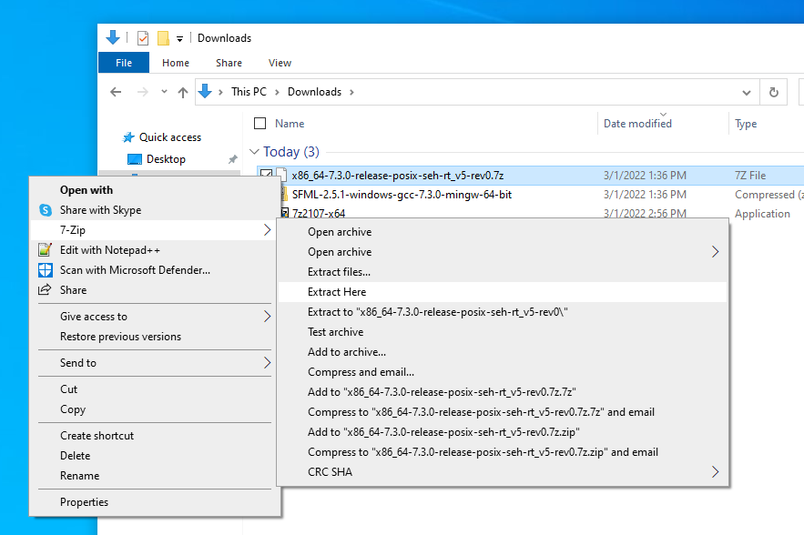
Extract MinGW
Go to your Downloads folder
Right-click the MinGW archive file
Select: 7-zip > Extract Here

Slide 7
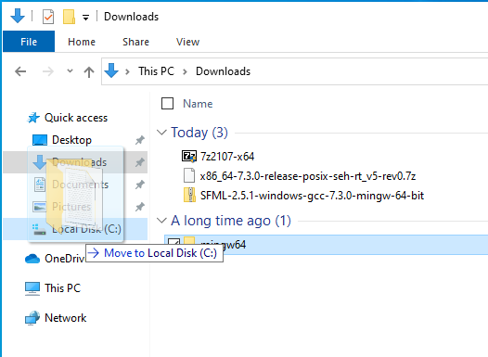
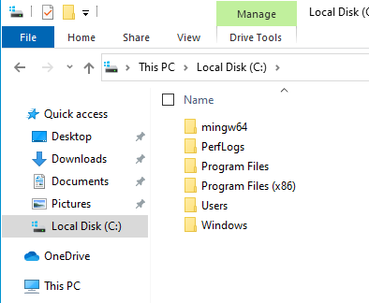
Move MinGW
7zip will extract a mingw64 folder
Move this folder to your root C:\ drive
You can just drag it onto your drive
You should see the mingw64 folder in your root C:\ path after

Slide 8
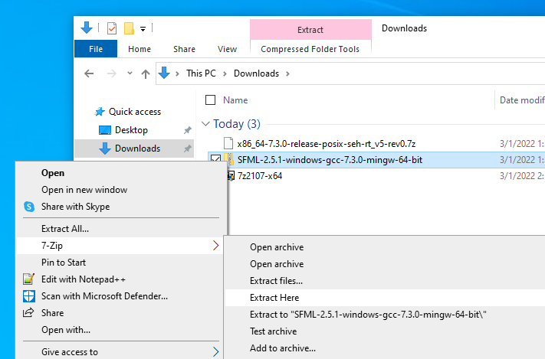
Extract SFML
Go to your Downloads folder
Right-click the SFML archive file
Select: 7-zip > Extract Here

Slide 9
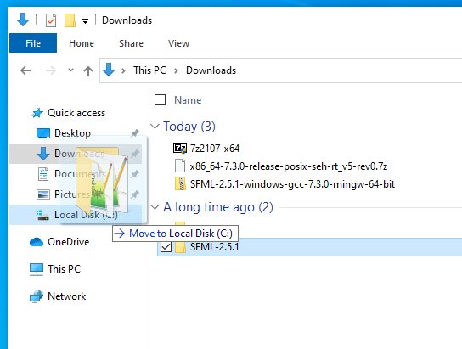
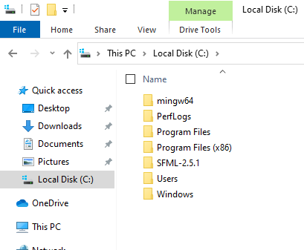
Move SFML
7zip will extract a SFML-2.5.1 folder
Move this folder to your root C:\ drive
You can just drag it onto your drive
You should see the SFML-2.5.1 folder in your root C:\ path after

Slide 10
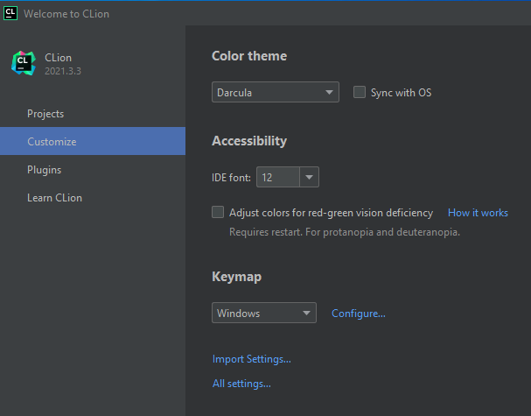
Customize CLion
We need to point CLION to the downloaded MinGW
Launch CLion
Choose Customize
Click All settings…

Slide 11
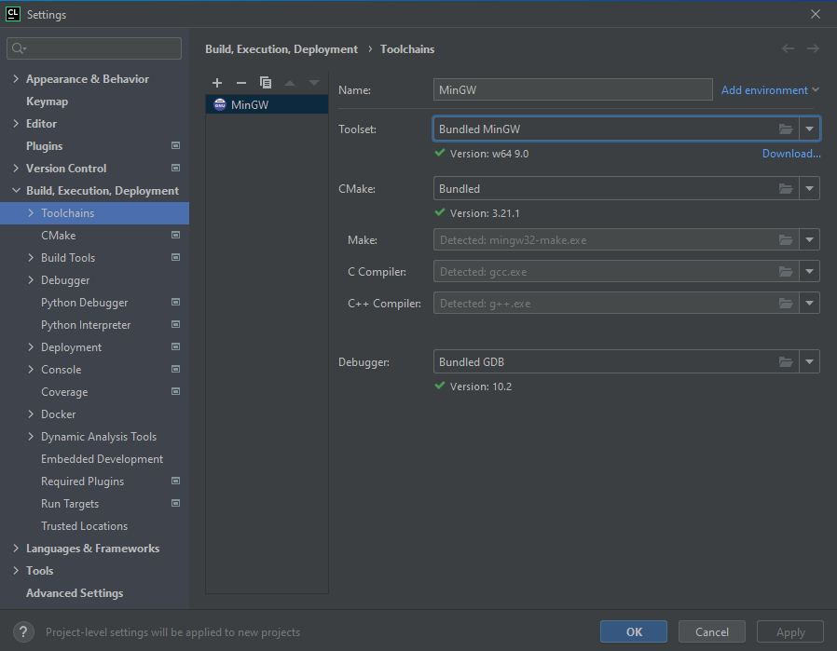
Edit Toolchains
Expand: Build, Execution, Deployment
Click Toolchains
You should see Toolset: Bundled MinGW

Slide 12
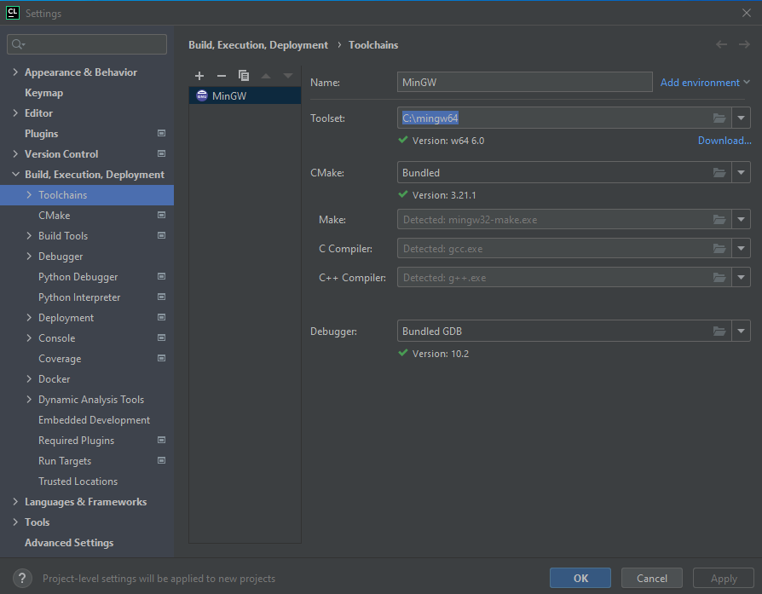
Set MinGW64
Change the Toolset to the root path to the MinGW64 folder you downloaded.
Toolset: C:\mingw64
Wait and you should see the Make, C Compiler and C++ Compiler detected
CMake and Debugger may stay set to the Bundled MinGW, which is fine
Click OK

Slide 13
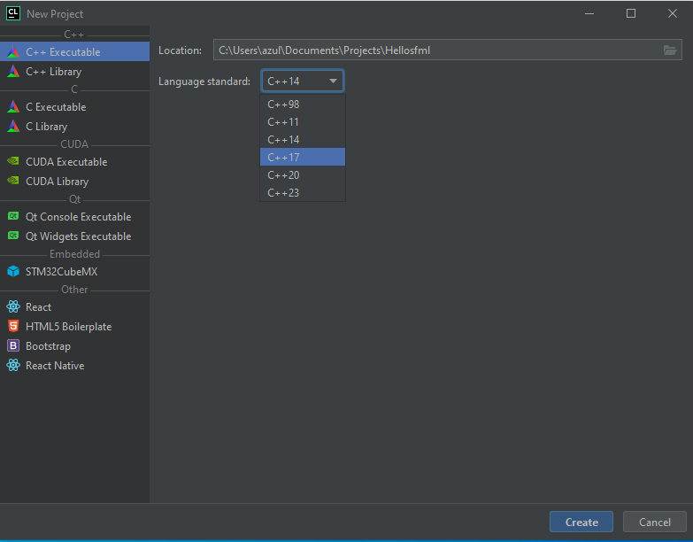
New Project
Select Projects and click New Project
Start a new project
Name your project
Select at least C++17
Press Create

Slide 14
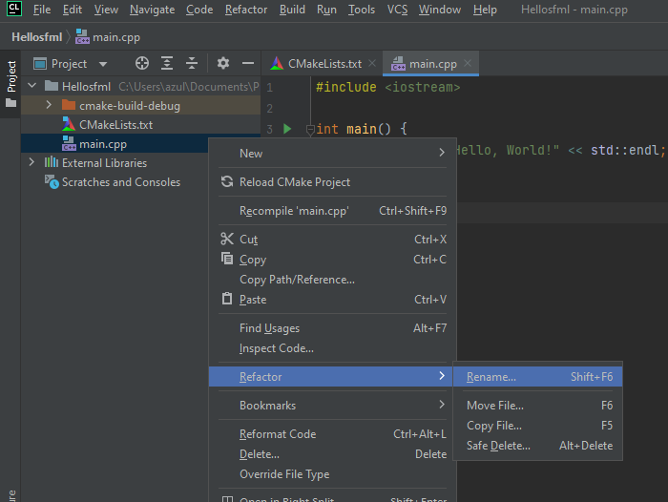
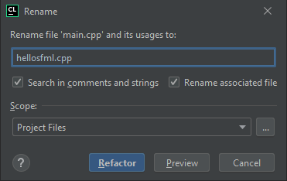
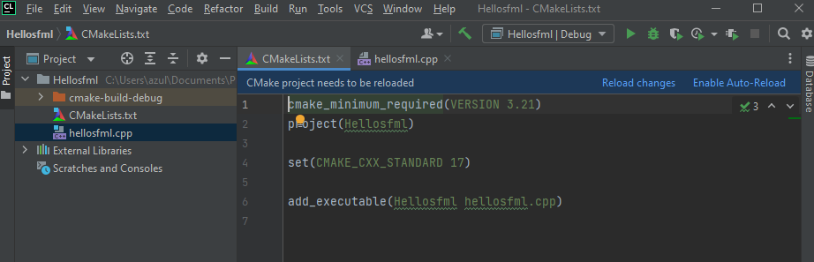
Rename main.cpp
Right-click the main.cpp file in the Project Explorer window and select Refactor > Rename
Change the name to “hellosfml.cpp” and click Refactor
This will update the name of the physical file, and change the name of it in the CMakeList.txt file
Click Reload changes to update the build settings for your project

Slide 15
Add SFML to CMakeList.txt
Set properties for the location of SFML libraries
Set a property that tells SFML to link the libraries statically to your project
Static linking mean library code is physically copied into your project executable by the linker
Set the location of include files (header files)
Set the location of library files (object code)
Tell the linker which libraries to locate
Tell the linker the specific library files
cmake_minimum_required(VERSION 3.21)
project(HelloSfml)
set(CMAKE_CXX_STANDARD 17)
set(SFML_ROOT "/SFML-2.5.1")
set(SFML_INCLUDE_DIR "C:/SFML-2.5.1/include")
set(SFML_LIBRARY_DIR "C:/SFML-2.5.1/lib")
set(SFML_STATIC_LIBRARIES TRUE)
include_directories(${SFML_INCLUDE_DIR})
link_directories(${SFML_LIBRARY_DIR})
find_package(SFML 2.5.1 COMPONENTS system window graphics network audio)
add_executable(HelloSfml hellosfml.cpp)
target_link_libraries(HelloSfml sfml-graphics sfml-window sfml-system)
Make sure this matches your project name

Slide 16
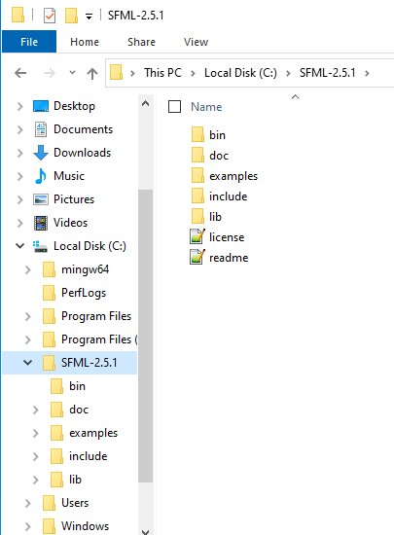

SFML Paths
Make sure paths match exactly
I copied my SFML folder “SFML-2.5.1” to the root of my “C:\” drive
Note paths in the CMakeList.txt file use the forward slash “/”
The SFML_ROOT property does not specify the drive letter. This worked best through trial-and-error.

Slide 17
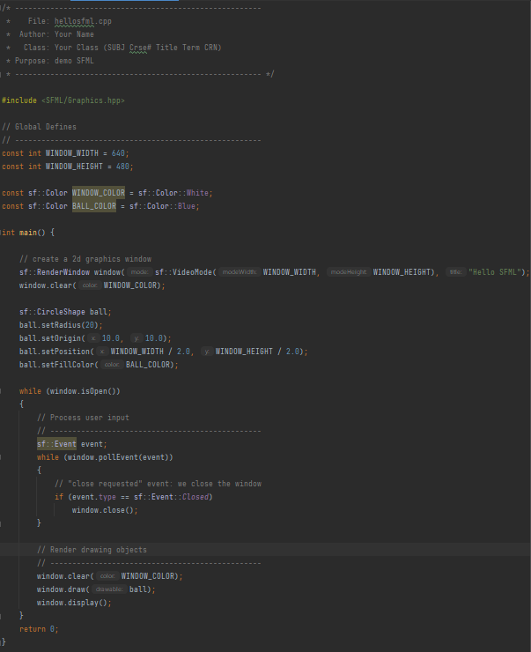
Copy Code
Download the source code for the Hello SFML project from your Canvas course
copy and paste the code to your “hellosfml.cpp” file
or simply replace the file in your project folder with the one you downloaded
You code should look like what you see on the right
Make sure to update the file-header comment for your Name and Class

Slide 18
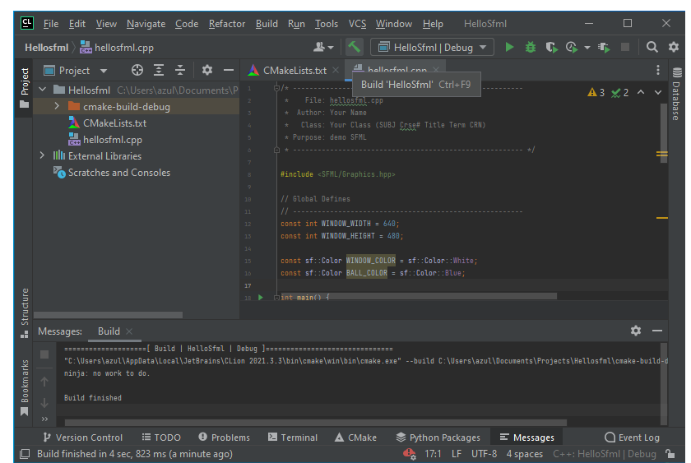
Build HelloSFML
Click the Build toolbar icon
Check Messages to make sure you do not have any build errors

Slide 19
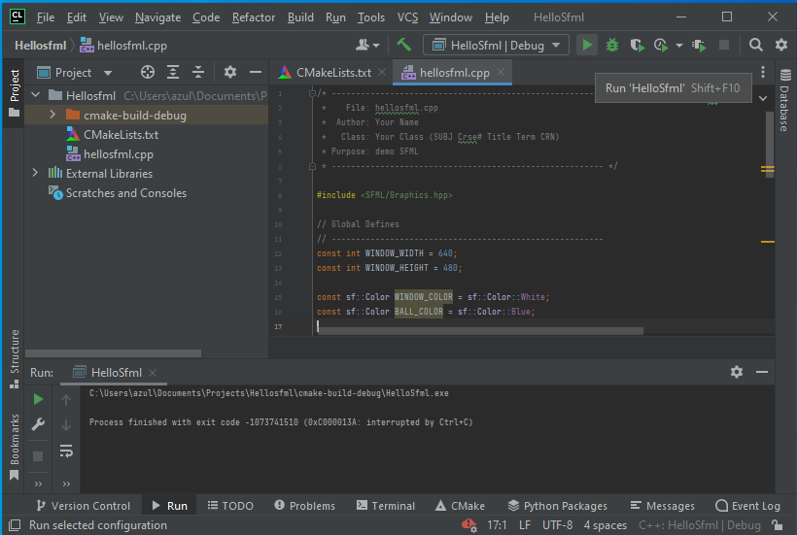
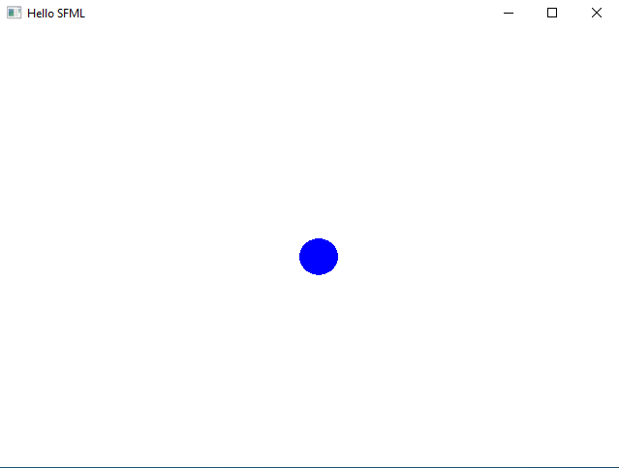
Run HelloSFML
Click the Run icon in the toolbar
You should get a window with a white background and a blue circle in the center

Slide 20
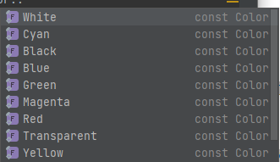
Make Changes
Some areas of the code that you can have fun with:
Change the size of the window
Change the color of the window and ball
Change the size of the ball
Change the location of the ball (it is currently centered in the window)
Available colors:

